Slide 1
Automated Detection and Repair of Incompatible Uses of Runtime Permissions in Android Apps
Malinda Dilhara
University Of Moratuwa
Sri Lanka
Haipeng Cai
Washington State University
Pullman, WA, USA
John Jenkins
Washington State University
Pullman, WA, USA
Notes:
Thanks for the introduction.
I am John Jenkins from Washington State University. As the first author could not make the trip, I will present our paper “automated ….”.
Our work deals with Android app incompatibilities caused by incompatible permission use, we propose an automated solution to detecting and repairing runtime permission induced incompatibilities.

Slide 2

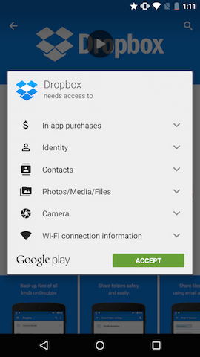
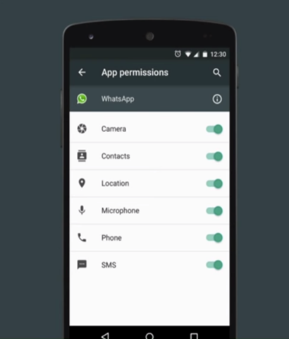
Introduction
pre-Marshmallow permissions
Android M and after permissions
Per-App controls for each permission
All permissions can be managed by the user
Available anytime after app installation
All the permissions should be granted with app installation
Permission can not be revoked after installation
Ref:https://github.com/codepath/android_guides/wiki/Understanding-App-Permissions
Ref:https://fpf.org/2015/06/23/android-m-and-privacy-giving-users-control-over-app-permissions/
Notes:
Android permission mechanism plays a major role on securing highly sensitive data of the Android system. Prior to Android-6.0 - Marshmallow, the user grants required permission at installation time and application will be able to access all the granted resources without any further acknowledgement during runtime. This creates permission related security concerns to the Android users. After Android-6.0 -Marshmallow, users are privileged to revoke granted permission any time after application installation. Android applications must request run time permission when the application need access to resources where system permission is required.

Slide 3

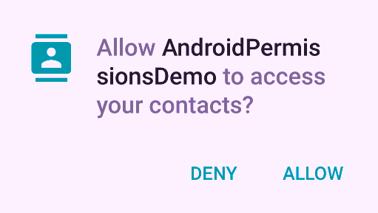
Introduction Cntd.
Notes:
All the applications which were developed targeting earlier versions of Android SDK must be revamped to facilitate the new Android runtime permission mechanism. Application developers must make sure to code their applications to request non-granted permission from the user at runtime.

Slide 4




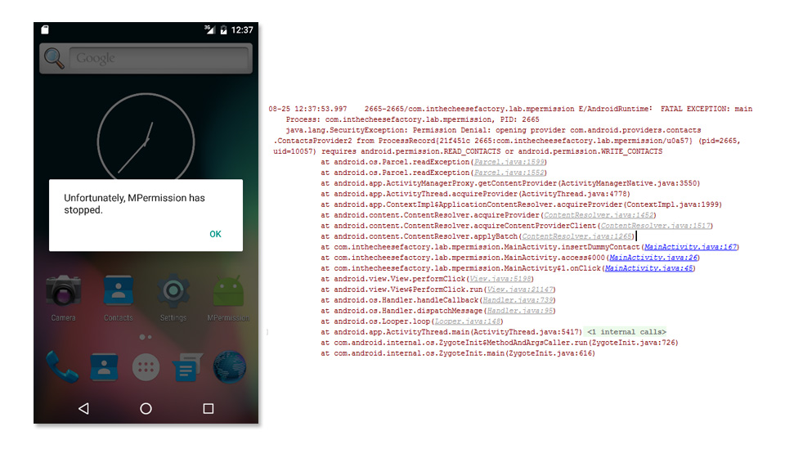
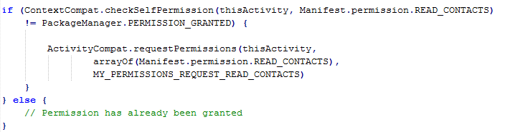
Problem Statement
Success
Failure
If (Red){
Stop
}
Else{
Go
}
Example of checking and requesting ability to read contacts
Notes:
As the illustration given in this slide, the train needs to follow the traffic light signal that indicates whether the road is clear or not. Otherwise the train will crash when it reaches to the cracked spot of the railway track.
Likewise, With the new, runtime model, users are privileged to revoke previously granted permissions or grant permissions any time after app installation. Thus, Android apps are required to check if permissions are still available for invoking an API that needs the permissions at the time of the API invocation and, if not, request missing permissions before calling the API. If those checks and requests are not properly implemented, the legacy applications could be crashed at the first exercised callsite of the API that needs permissions not granted when the API is invoked on devices with Android version 6 or higher. An example for such check and request for READ CONTACT is given in this slide.
The code inside the if condition is responsible for obtaining non-granted permission and else condition continues the code if all the permissions are granted. If the code is not implemented like this, the application crashes when it reach to a callsite which tries to invoke permission required API
(then talk briefly with the example – in general, we should never have something on a slide and then just ignore them during presentation; if you show something, then must talk about it, however a little bit you would do for it)

Slide 5

Problem Statement CNTD.
What shall happen to the legacy applications ?
Potential Solutions | Issues of potential solutions
Drop legacy applications and develop them from scratch | Large resource waste thus may not be practically acceptable
Modify the source codes by inserting check and requests | Excessive human efforts, in addition to being error-prone. Source code might not be available
Notes:
With these essential modification as described in the previous slide, developers should prepare their applications for new platforms.
To mitigate the problem, couple of solutions can be suggested. Legacy applications could be dropped and redeveloped from scratch. This solution demand high costs and could be a resource wastage. The other solution is to manually go through the source code and spot the methods where permissions are needed and guard them using permission requesting methods. Several libraries have been developed to help the application developments when dealing with the new permission mechanism, one such example is PermissionsDispatcher which is based on Java annotations and it helps to guard the permission required methods. Even though such libraries help developers effectively, still developers need to open the old source codes and revamp the code using those libraries. Updating individual application to be compatible with new runtime permission is time consuming. This might even be impossible due to the unavailability of source code.

Slide 6


Solution
We propose a fully automated solution that helps mobile developers deal with runtime permission related compatibility
abc.apk
Fully automated system
abc.apk
I am not adapted to new permission mechanism
Now, I am not afraid of performing on new platforms (>M)
Detect
Repair
Validate
Notes:
Due to the overhead of proposed solutions, we propose to develop a technique that detects the compatibility issues in a given application and fixes them when found, hence automatically adapting the application to run-time permission mechanism. Our technique contains three modules, detection module to detect non-adapted apps, repair module to repair and transform applications and validation module to validate the transformed applications. Our approach realizes the adaptation through static bytecode analysis and transformation without accessing the source code of the app.

Slide 7
Methodology
API-permission mapping
Static control flow analysis
Runtime permission
incompatibility detection
Incompatible?
Input
Original Android app (APK)
Soot
Yes
Runtime permission
incompatibility repair
No
Resulting
Android app (APK)
Transformed app validation
Adaptation report
Output
Notes:
This is the overview of our technique. We first feed API-Permission mapping file and the legacy application to the system. The first task is to decide whether the application is compatible or not. If it is incompatible for the new run time permission mechanism it moves to the repair stage, otherwise the original application will be delivered as it is. At the repair stage the application will be modified by inserting required permission check and requests. Then in the validation stage, the modified application will be validated by running the same incompatibility detection algorithm on it. If the application is successfully modified, the modified application will be delivered as a well adapted application to android new runtime permission mechanism. (when presenting, make sure using finger or laser pointer to walk the audience through the flow)

Slide 8
Methodology – Incompatibility detection, repair and validation
1. Every permission-dependent API callsite in each PRC is dominated by the true branch of a permission check ?
2. The false branch of the check is post-dominated by permission requests for all the permissions required by the API ?
Backward traversal on the call graph until the Permission responsible caller of the API is reached (PRC)
API-permission
mapping
PRCs
Construct call graph
Find the use of permission needed API
Original
Android app (APK)
Run the incompatibility detection algorithm and check the compatibility
1. Guard PRC from check and requests
2. Create a permission response handler PRH with respect to permissions
Yes
Adapted Android app (APK)
No
For every PRCs
Original
Android app (APK)
For every incomplete PRCs
Repair
Notes:
The system first contstruct the call graph and based on the call graph and the control flow graph (CFG) of each method in the app, the static analysis continues with localizing incompatible permission uses, using the input API-permission mapping. To identify the error locations, our analysis performs a forward traversal on the call graph. Whenever a permission dependent API is encountered, the analysis starts a backward traversal on the call graph until the Permission responsible caller of the API is reached. We define the PRC of a method as the closest caller of the method that is defined in the user code of the app. The PRC of an API is thus found through a backward depth-first search on the call graph.
When the PRC is found, our detection algorithm runs to identify each and every PRCs are guarded by the permission request and check API methods. To check this, our algorithm checks two conditions. First one is, every permission-dependent API callsite in each PRC is dominated by the true branch of a permission check, the other condition is, the false branch of the check is post-dominated by permission requests for all the permissions required by the API . If two conditions are met by each and every PRCs, then the application is identified as an adapted application otherwise it is not.
If the application is detected as a non-adapted application it proceeds for the repair stage. The code transformation ensures that the original callsite will fall in the true branch of the check API. If the check fails, a call for requesting all the required permissions will be inserted. After all incompatible APIs in a PRC are repaired, the algorithm ensures there is a permission request response handler, which will be invoked by the platform when the permission-request dialog is closed included in the class that encloses the PRC.
After the repair stage the validation module ensures that the transformed app is properly adapted by re-running the detection algorithm on it. The validation passes if it is detected as a compatible application.
(again, during presentation, make sure using some hints to show the flow gradually so that the audience see what the algorithm works step by step).

Slide 9
Results - Experimental procedure
App selection
We Randomly selected 23 android applications from Google play
Manual compatibility check
Manually produced the ground-truth compatibility with respect to the runtime permission model
Automated compatibility check with ARPDroid
Repaired all incompatible applications with ARPDroid
Automated adaptation with ARPDroid
We then ran ARPDroid to detect whether the app is incompatible or not
Manual verification
We ran the app on an Android emulator that has Android 6.0 (API level 23) installed, and then extensively navigated the app with manual inputs (especially permission-dependent operations and permission granting/revoking) to check if the app functions normally on the new platform.
Notes:
We have implemented our technique as an open-source tool, ARPDroid. As a preliminary evaluation of our approach, we randomly selected 23 popular, real-world Android apps from Google Play and applied ARPDroid to each of them. In the next step, we manually checked the compatibility by revoking permission and running the application on Android – M. After that we run the tool to check whether it is correctly detecting incompatibility of apps. As the next step, proceeded with the incompatibility repair step. Each repaired app was initially validated by running the detection algorithm again. Next, we manually verified whether the app is indeed compatible with the runtime by running the app on an Android emulator that has Android 6.0 installed, and then extensively navigated the app with manual inputs permission model.

Slide 10
Results
Benchmark((package name) | Size(MB) | Ground truth | Detected as | Adaptation | Total time (s)
yogi.corporationapps.telescope.bigzoomhd | 2.81 | incompatible | incompatible | succeed | 123.4
photo.album.galleryvault.photogallery | 2.79 | incompatible | incompatible | succeed | 137
com.flashlight017.app | 1.13 | incompatible | incompatible | succeed | 174.8
internet.signal.speed.booster | 1.52 | incompatible | incompatible | succeed | 263.6
com.softwego.applock | 3.18 | incompatible | incompatible | failed | 323.6
com.huawei.netinfo3d | 41.53 | incompatible | incompatible | succeed | 178.8
com.sand.airdroid | 21.92 | incompatible | incompatible | succeed | 220.1
com.google.android.launcher | 14.56 | compatible | compatible | succeed | 143.4
com.bloketech.lockwatch | 0.23 | incompatible | incompatible | succeed | 50.3
com.jvckenwood.ao2.kenwood.musicplay | 0.39 | incompatible | incompatible | succeed | 45.7
bb.andry.hack | 0.91 | incompatible | incompatible | succeed | 89.8
com.jvckenwood.ao2.jvc.musicplay | 0.92 | incompatible | incompatible | succeed | 61.3
com.facebook.orca | 47 | compatible | compatible | succeed | 63.7
ur.control.television.rimote.toolss | 1.22 | incompatible | incompatible | succeed | 66.9
connection.stabilizer.powersignals | 1.45 | incompatible | incompatible | succeed | 104.7
com.barcode.home.nga | 3.18 | incompatible | incomplete | failed | 157.8
com.aliengod.zoom | 1.5 | incompatible | incompatible | succeed | 87.8
com.latestnewappzone.autoflashoncallsms | 1.82 | incompatible | incompatible | succeed | 138.8
com.miragestack.secret.voice.recorder | 2.31 | incompatible | incompatible | succeed | 148.9
com.piggy.myfiles | 2.35 | incompatible | incompatible | succeed | 148.9
com.geekslab.screenshot | 2.59 | incompatible | incompatible | succeed | 154.5
com.skype.raider | 36 | compatible | compatible | succeed | 52.6
com.mantishrimp.salienteyeremote | 4.52 | incompatible | incompatible | succeed | 122.1
overall | average=8.50 | Accuracy=100% | success | rate=91.3% | average=133.0
Notes:
Our results with respect to benchmark applications show promising effectiveness and practical efficiency of our technique.
As shown in Table 1, for the 20 benchmarks that are actually incompatible, ARPDroid detected them all correctly as incompatible, and successfully repaired 18 of them. The resulting apps work normally on the new platform of Android (version 6.0) with respect to extensive manual inputs. The overall transformation success rate was 91.3%.

Slide 11
Limitations
No capability of inserting ActivityCompat.shouldShowRequestPermissionRationale()
Dependence of the underlying utilities such as FlowDroid, ARPDroidwould
Notes:
There are two major limitations that can be seen in ARPDroid.
Currently ARPDroid inserts code to directly request permissions without considering showing additional rationale to the user. In other words, implementation of ActivityCompat.shouldShowRequestPermissionRationale will not be done through the ARPDroid.
Secondly, a main implementation limitation lies in the dependence of our tool on the capability of Soot and Flow-Droid: ARPDroid would not be able to handle apps that cannot be successfully processed by these underlying utilities.

Slide 12

None adapted applications to new runtime permission mechanism, crash in new android platforms (>=android-M).
Modifying legacy (<android-M) android applications to adapt new runtime permission mechanism is time and resource consuming.
We developed an automated technique to solve this problem.
We implemented the proposed technique and made the tool as an open source tool – ARPDroid (https://bitbucket.org/malindadoo/arpdroid).
If you are interested, please find more details in our paper.
Automated Detection and Repair of Incompatible Uses of Runtime Permissions in Android Apps
Malinda Dilhara
University Of Moratuwa
Sri Lanka
Haipeng Cai
Washington State University
Pullman, WA, USA
John Jenkins
Washington State University
Pullman, WA, USA
Notes:
We developed an open source automated tool for adapting legacy android applications for new runtime permission mechanism and it is available for you to check and give your feedback on it.
Instead of showing this long sentence, we may show short phrases to summarize the problem we solve, and contributions we make in this paper.
Then, show the paper title with author info. Saying that “if you are interested, please find more details in our paper”.

